Slide 1

Control of a Rolling Balancing System
Timothy Dunn

Slide 2
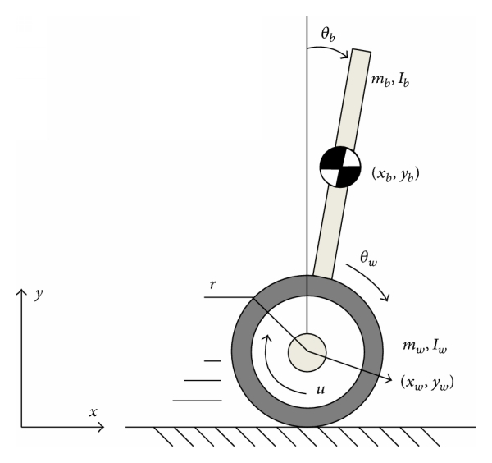
Under-Actuated Systems
https://www.hindawi.com/journals/mpe/2014/284216/fig1/

Slide 3
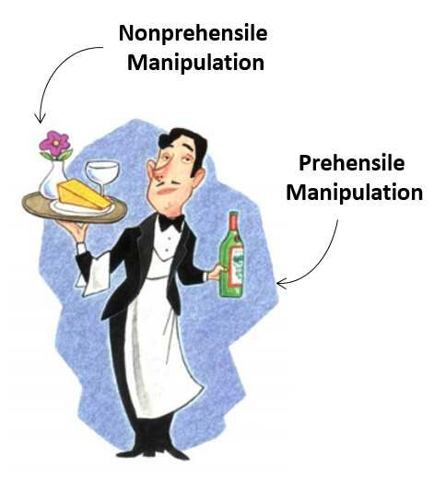
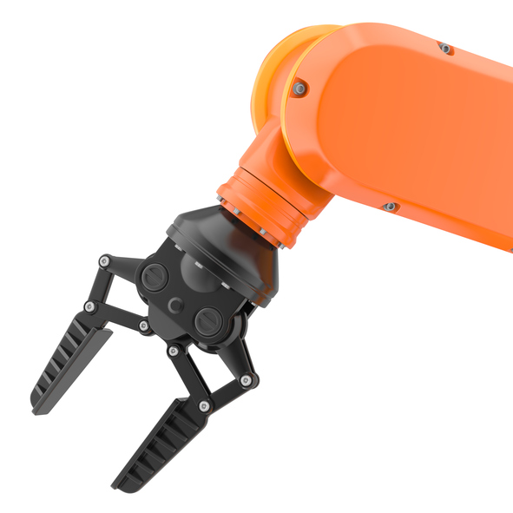
Prehensile Manipulation
https://www.researchgate.net/publication/310751102_Robot_Control_for_Nonprehensile_Dynamic_Manipulation_Tasks
https://www.robotics.org/blog-article.cfm/The-Emergence-of-Smart-Collaborative-Robot-Grippers/107

Slide 4
Primitives
Rolling
Sliding
Pushing
Throwing

Slide 5
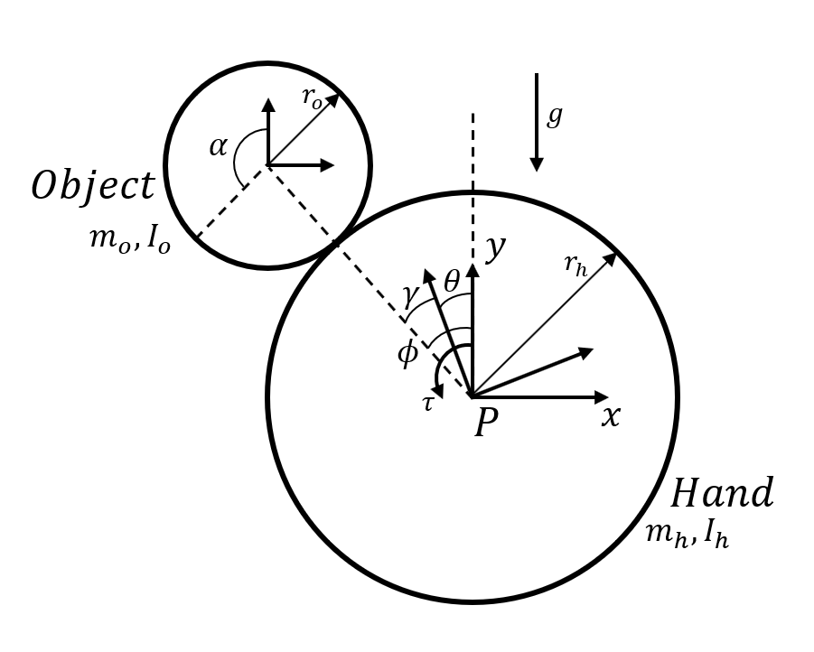

Modelling
$$\left[\begin{matrix}J_{h}+J_{o}\frac{r_{h}^{2}}{r_{o}^{2}} & {−J}_{o}\frac{r_{h}^{2}}{r_{o}^{2}} \\ {−J}_{o}\frac{r_{h}^{2}}{r_{o}^{2}} & m_{o}{\left(r_{h}+r_{o}\right)}^{2}+J_{o}\frac{r_{h}^{2}}{r_{o}^{2}}\end{matrix}\right]\left[\begin{matrix}\ddot{θ} \\ \ddot{ϕ}\end{matrix}\right]+\left[\begin{matrix}0 \\ −m_{o}g\left(r_{h}+r_{o}\right)sin⁡(ϕ)\end{matrix}\right]=\left[\begin{matrix}τ \\ 0\end{matrix}\right]$$

Slide 6

Control
Linear-Quadratic Regulator
Setpoint tracking with reference-feedforward
Minimise $𝒱=\sum_{k=0}^{∞ }{x_{k}^{T}Q_{d}x_{k}+u_{k}^{T}R_{d}u_{k} where Q_{d}≥0, R_{d}>0}$

Slide 7
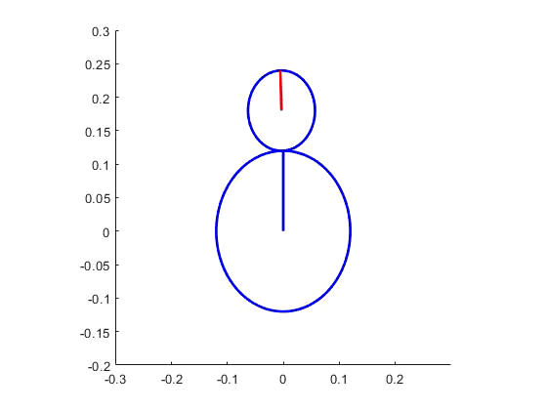
Control

Slide 8
Experiment Apparatus Design

Slide 9
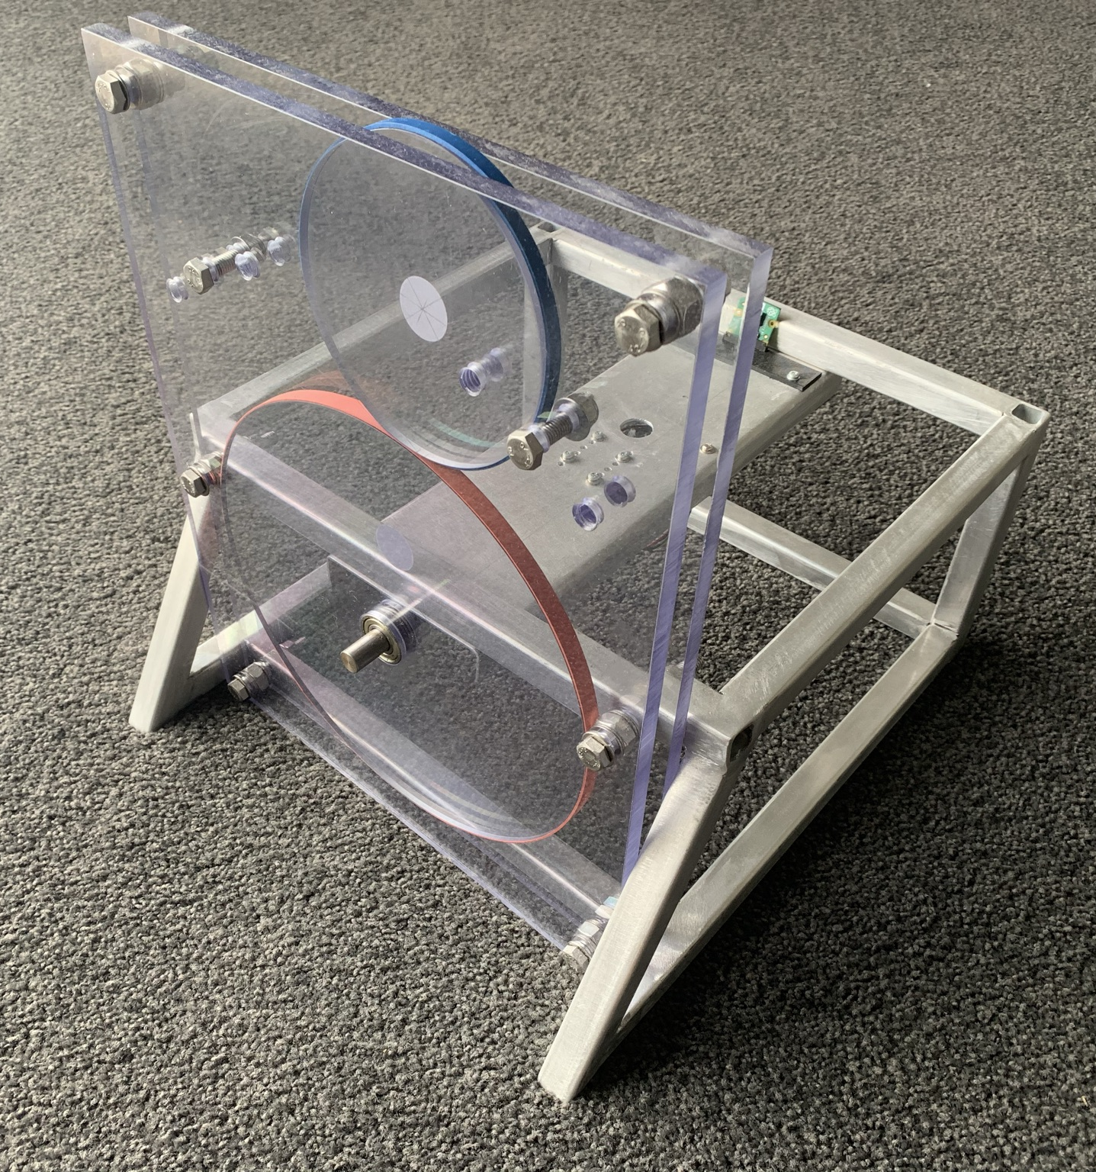
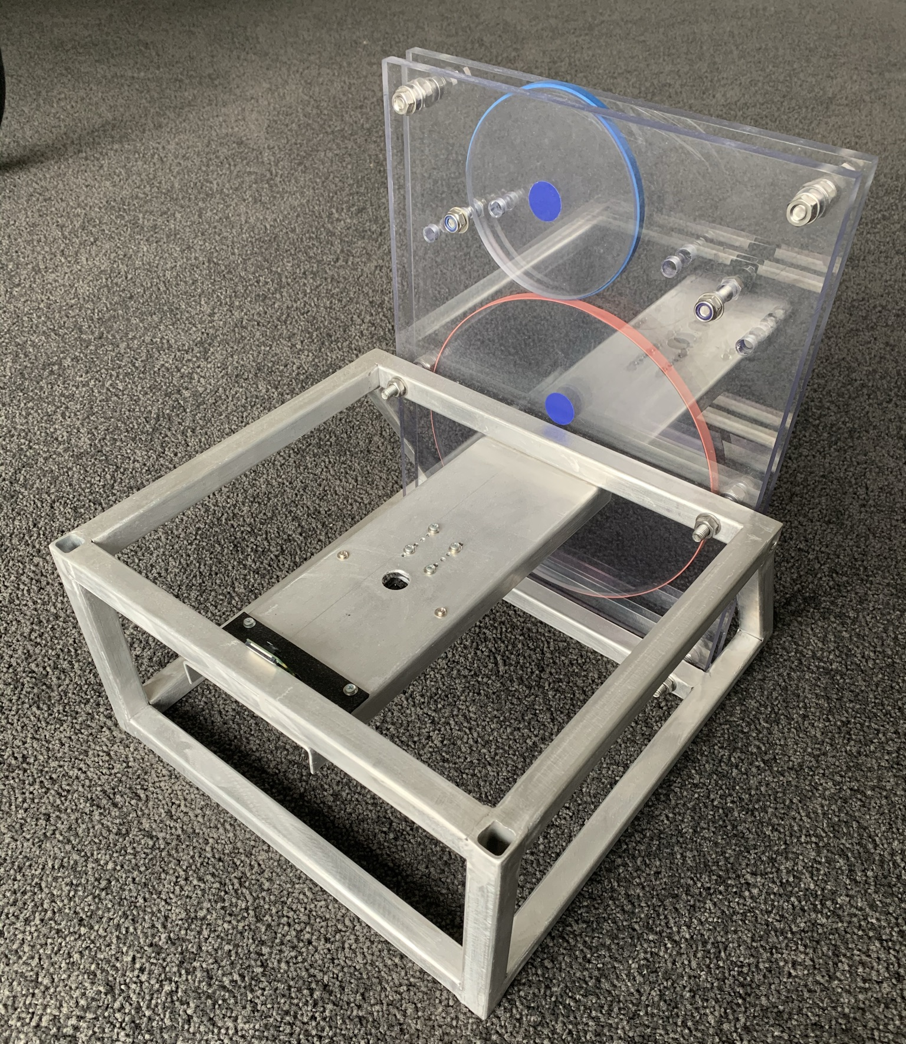
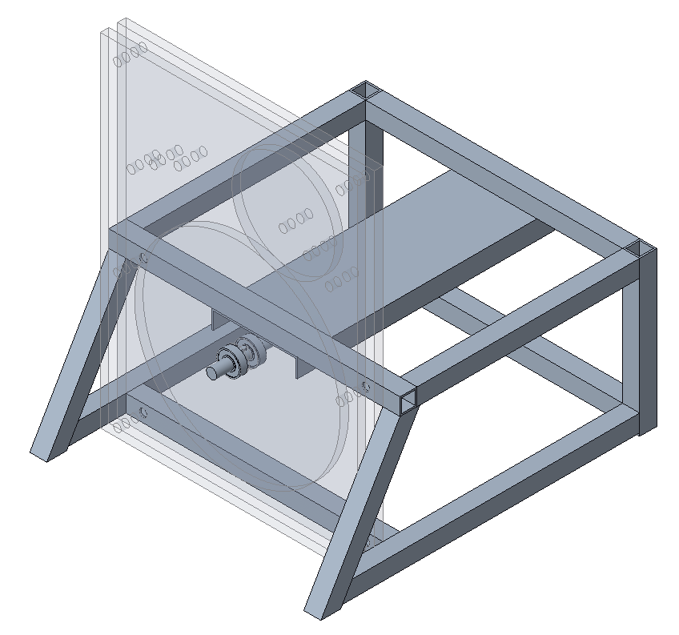
Experiment Apparatus Design

Slide 10
State Estimation
Bottom disk: rotary encoder on motor output shaft
Top disk: computer vision

Slide 11
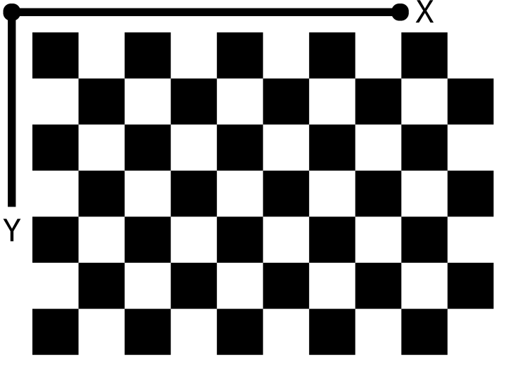
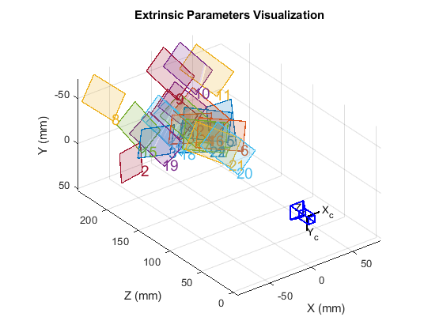
Camera Calibration

Slide 12
Image Distortion
Distorted Image
Undistorted Image

Slide 13
Saturation Thresholding
Hue, Saturation and Value (HSV) Representation
Binary Representation

Slide 14
Blob Detection

Slide 15
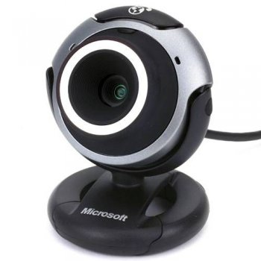
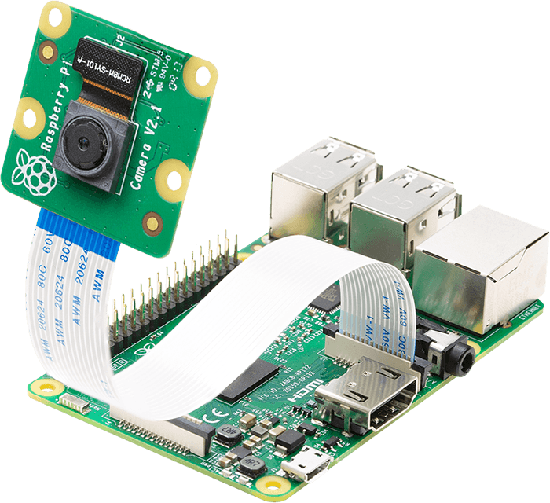
Computer Vision Implementation
Microsoft
VX3000 Webcam
Raspberry Pi
Camera
https://www.arducam.com/wp-content/uploads/2020/02/raspberry-pi-camera-pinout-camera-2.png

Slide 16
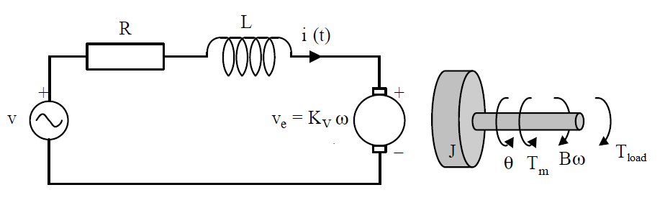
DC Motor System Identification
DC Motor Model

Slide 17
Friction Model

Slide 18
Final Motor Model

Slide 19
Proportional-Integral Control Allocation

Slide 20

Current Project Status
Implementation complete, stability not achieved
Making attempts to reduce image availability input latency

Slide 23
Reprojection Errors

Slide 24
The Project
Motivation
Modelling and Simulation
Implementation

